Slide 1

Diseaase Detection using ML bot
By: Naman Arora(19MIM10057)

Slide 2
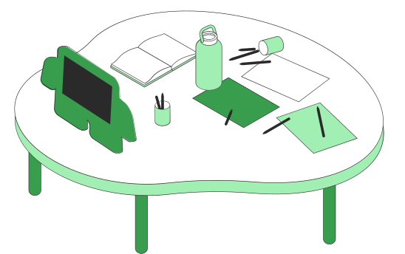
Introduction
Technology used
Architecture of Decision Tree
Benefits of using ML in health sector
Challenges in disease detection
Future Score
Screenshots
Github link
Reference
Conclusion
Content
What to Know

Slide 3

Introduction
As the days are passing by, we are relying more and more on technology.
The pandemic has thought us that health comes first.
Disease detection using AI & ML can be extremely useful

Slide 4
Technology used
Used the latest version of python(python 3.9) and many of its modules like NumPy, pandas, Tkinter, sklearn, etc.
Decision Tree algorithm was used for the development of the model.

Slide 5
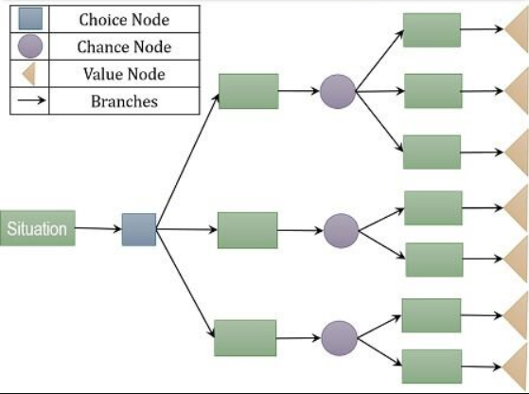
Architecture of Decision tree

Slide 6
25
FinTech segments according to transaction value
20
15
10
As of January 2021
5
Digital payments are leading the way followed by personal finance, alternative lending, and alternative financing.
0
Item 1
Item 2
Item 3
Item 4
Item 5

Slide 7

Benefits of ML in the health sector
Improving Clinical Health Data Management.
Processing large data sets for diagnosis
Improving healthcare in under-resourced areas
Speeding up Drug Development with AI

Slide 8

Challenges of AI in Health Sector
Massive pressure on healthcare systems.
The exponential growth of healthcare data.
Integration and legal challenges.
Producing efficient insights.

Slide 9



Future Scope
Efficient disease detecction
Faster diagnosis and analysis of data
New ideas and techniques of treatment

Slide 10
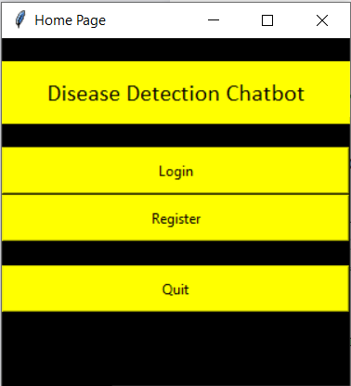
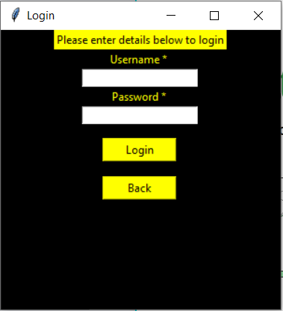
Screenshots

Slide 11
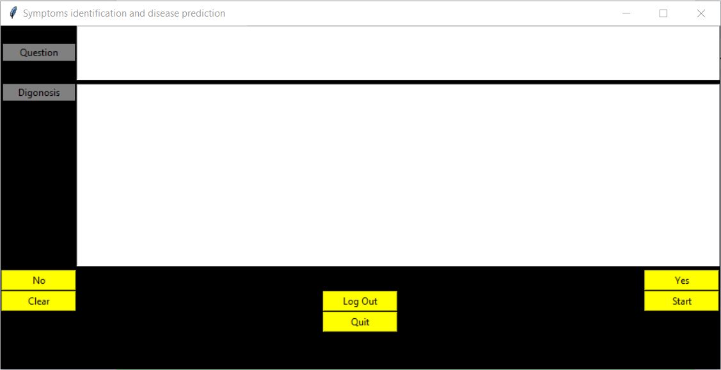
Screenshot

Slide 12

Github link
https://github.com/namanarora09/Disease-Prediction-Using-Machine-Learning

Slide 13
Artificial Intelligence (AI) in Healthcare: What Does the Future Hold? | HealthTech Magazine
What is Decision Tree Analysis? Definition, Steps, Example, Advantages, Disadvantages - The Investors Book
Challenges And Future Of AI In Healthcare (analyticsindiamag.com)
Reference

Slide 14

THANK YOU

